Slide 1
AppDynamics Engineer Training Chapter 7 – App Infrastructure Discovery – .NET Alex Fedotyev Sales engineer

Slide 2




Agenda
Configuring .NET agent
.NET node dashboards
IIS AppPool view
Gotcha’s
Notes:
.NET agent configuration covers several aspects which include use of automatic and manual mode, configuring monitoring of windows service, etc.
From the dashboard perspective it is important to understand the tier/node structure and the data displayed there.
IIS AppPool view explains the mapping between the IIS applications and AppDynamics nodes.

Slide 3
.NET monitoring configuration wizard
Logging
+
Controller
AppDynamics Application
Monitoring Settings
Restart IIS
Set logging folder location
Grant permissions to the logging folder
Configure connection to the controller
Configure monitoring using automatic mode
Or manually select apps for monitoring
Select exiting or create new AppDynamics application
Restart IIS to apply the monitoring
Notes:
Configuring .NET agent is done through the wizard which runs automatically after you install the agent. This wizard includes several steps.
First step is to configure log folders and access to those folders. Default location is c:\AppDynamics\Logs, and users can change it if they want.
Second step is granting permissions to the log folder to the accounts to make sure the agents can write those logs.
Then you configure the AppDynamics application, and enable monitoring for required .NET application on the server, and in the end restart IIS.

Slide 4
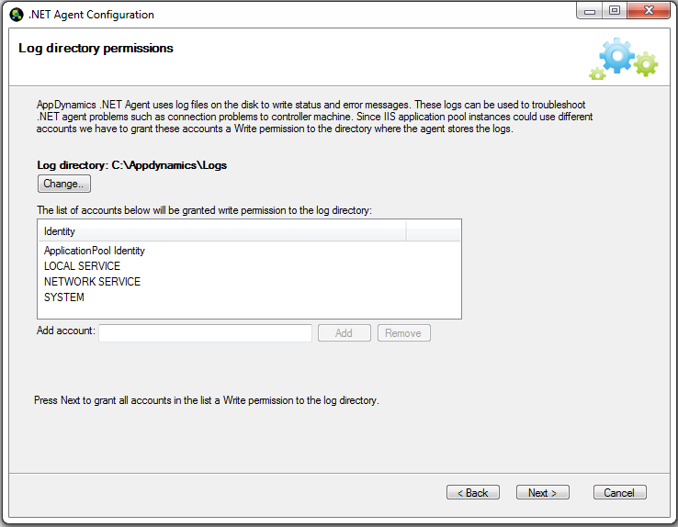
Configure agent log files location
Notes:
To configure log files verify the location of log folders and change it if required, and then check the accounts those will be writing to the logs.
App agents are running inside the application itself so need to make sure all possible accounts are listed here to have full log access.
Wizard scans the IIS AppPools and adds those accounts to the list automatically.
Missing the account will not break the monitoring but will make support harder since the logs will be missing.

Slide 5
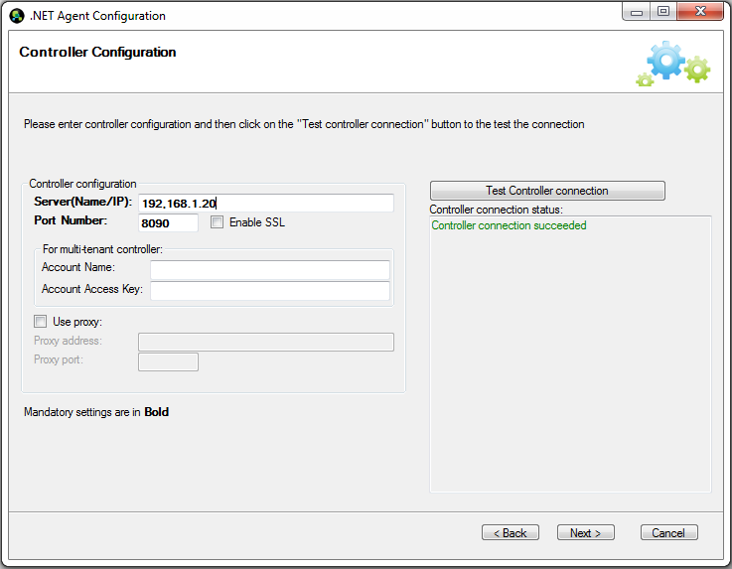
Configure connection to the controller
Notes:
Next steps is to configure connection to the controller.
For SaaS you will need to specify account name and key.

Slide 6
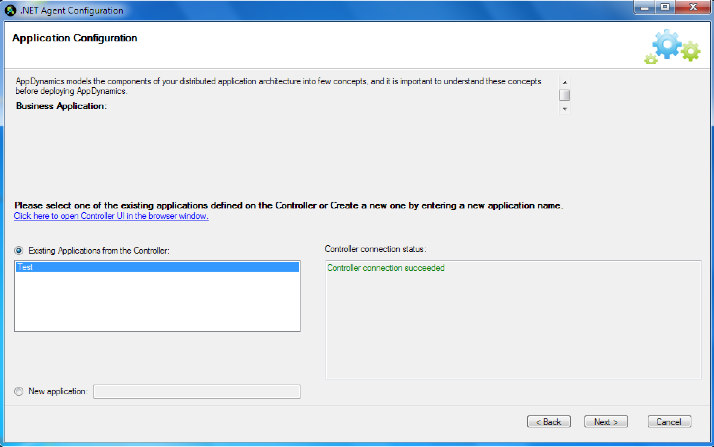
Selecting AppDynamics application
Notes:
Once the connection to controller is configured – user needs configure the AppDynamics application where all .NET applications on this server would be reporting to.
Since wizard has the connection to the controller it will download the list of existing apps so user can just select existing one.
And for the first time setup it is possible to create a new application.
Having AppDynamics application configured properly is a very important step and users need to understand that they need to point all servers which are part of the same business application / environment to report to one AppDynamics application.

Slide 7
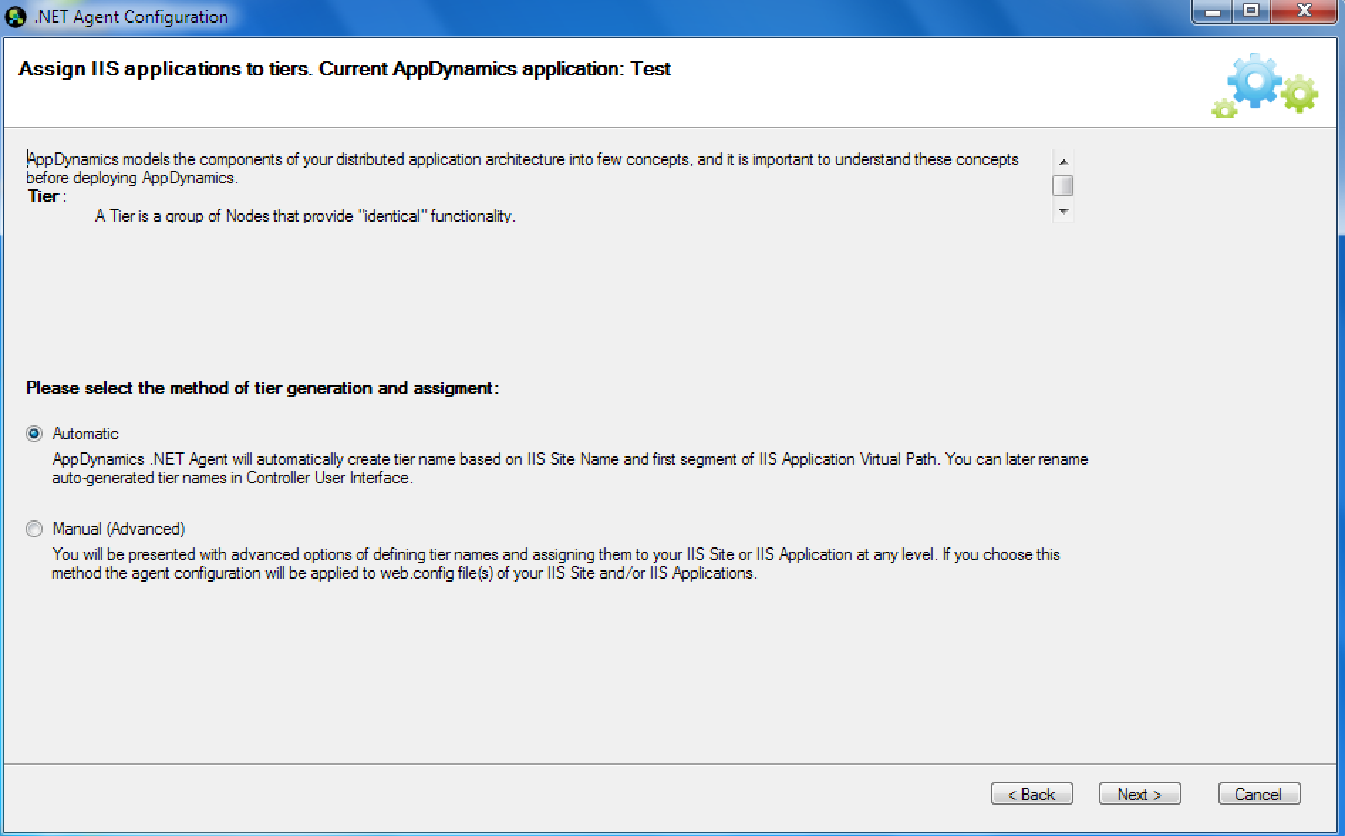
Automatic vs Manual mode
Notes:
There are two options on how to setup the tier assignment for the .NET applications.
Key item to understand is that one server may run multiple .NET applications which could be IIS web applications as well as windows services or executables, and each application is different and may need to be treated as a separate tier.
Therefor the configuration process need to define how to assign the .NET apps to the AppDynamics tiers.
Automatic option is the first option to try in this case, here is how it works:
When automatic mode is enabled agent will monitor all IIS .NET web applications
Each application will be assign to the dynamically created tier named this way: <IIS site name> – <IIS application name> (where application name will use only first segment of the IIS application path in order to limit the total number of tiers)
The configuration will be stored in the [InstallFolder]\AgentGlobalConfig.xml configuration file
IIS restart is required but can be postponed to the later time after the configuration process is completed and wizard is closed

Slide 8
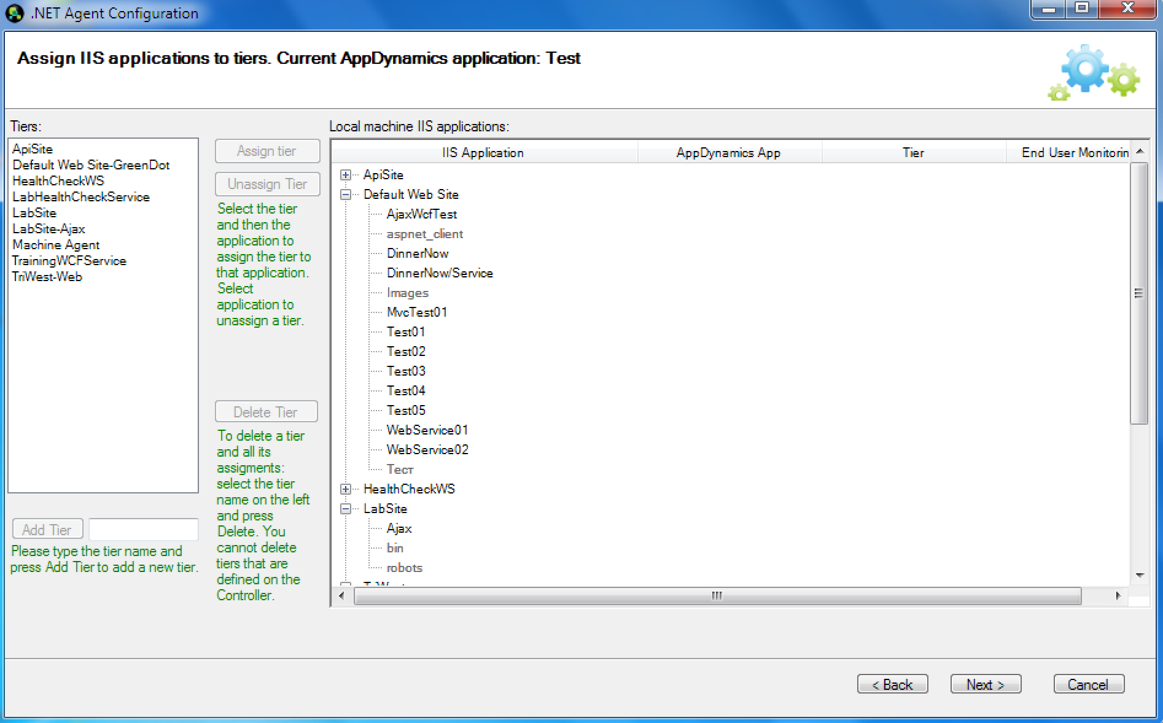
Manual mode tier assignments
Notes:
Manual configuration is a second option to configure monitoring of the IIS web applications.
It allows to enable any application to be monitored and assign it to any tier as a manual process.
For the first setup manually create the required tiers. Next time wizard will download the list of all tiers from the controller, so this won’t be required next time user runs the configuration wizard.
Select the tier on the left, IIS web application on the right and click assign to enable monitoring for each IIS application.
The IIS restart is required after the wizard is completed as the last step of the wizard, restart can’t be postponed.
Configuration is stored locally inside the application’s configuration file which is web.config file for each application configured for monitoring.

Slide 9
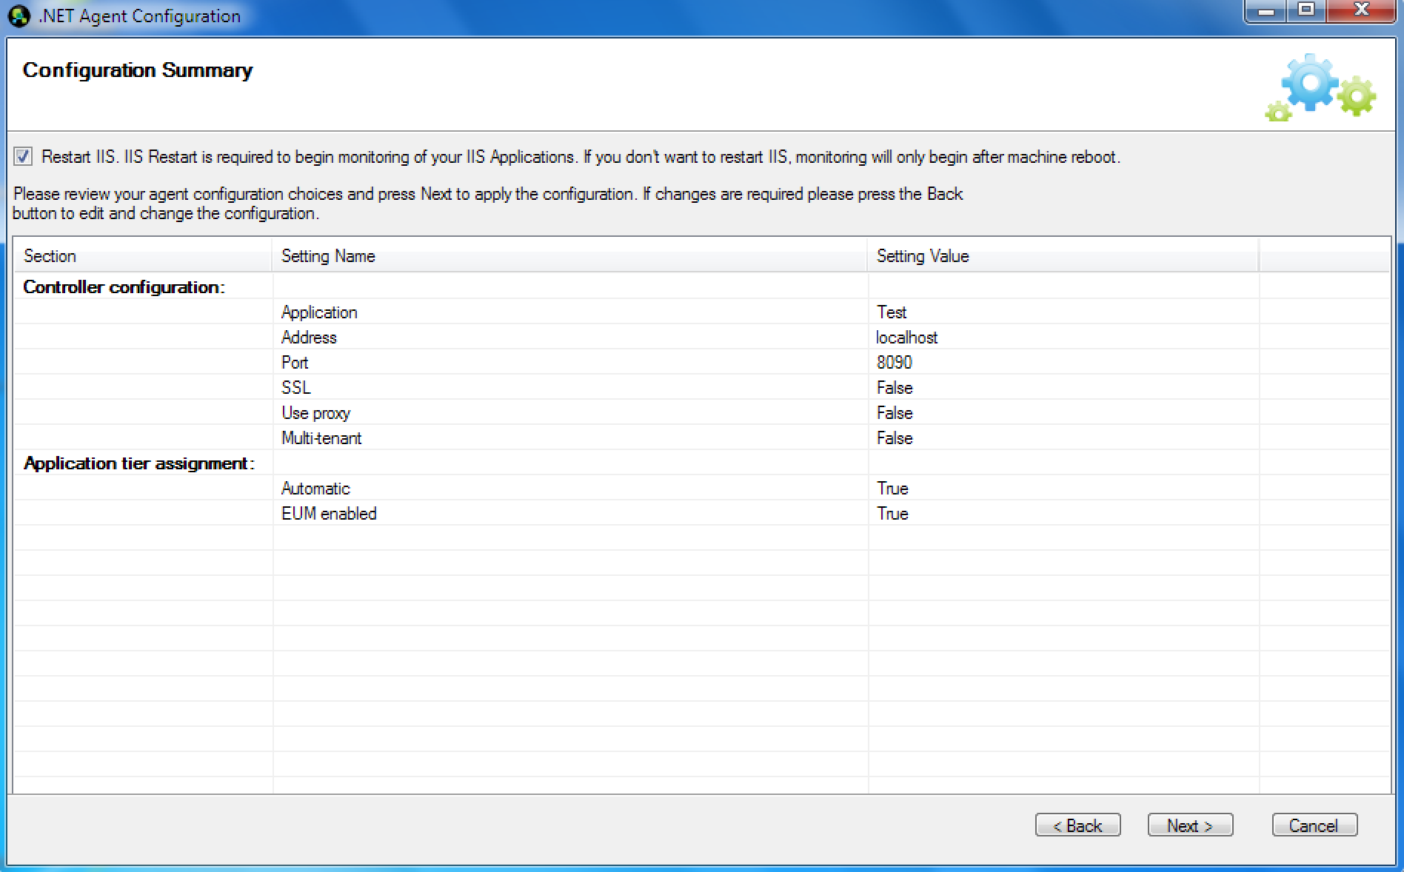
IIS restart requirements
Notes:
After the configuration is completed user will be required to restart the IIS.
The screenshot above shows the screen when the automatic tier naming configuration was used.
In this case it is possible to uncheck the “Restart IIS” option and do it later manually.
For the manual configuration there is no way avoid restarting IIS.
This is related to the fact that configuration is stored in the web.config file, and IIS monitors that file and recycles the IIS AppPools anyway when changes are detected.

Slide 10
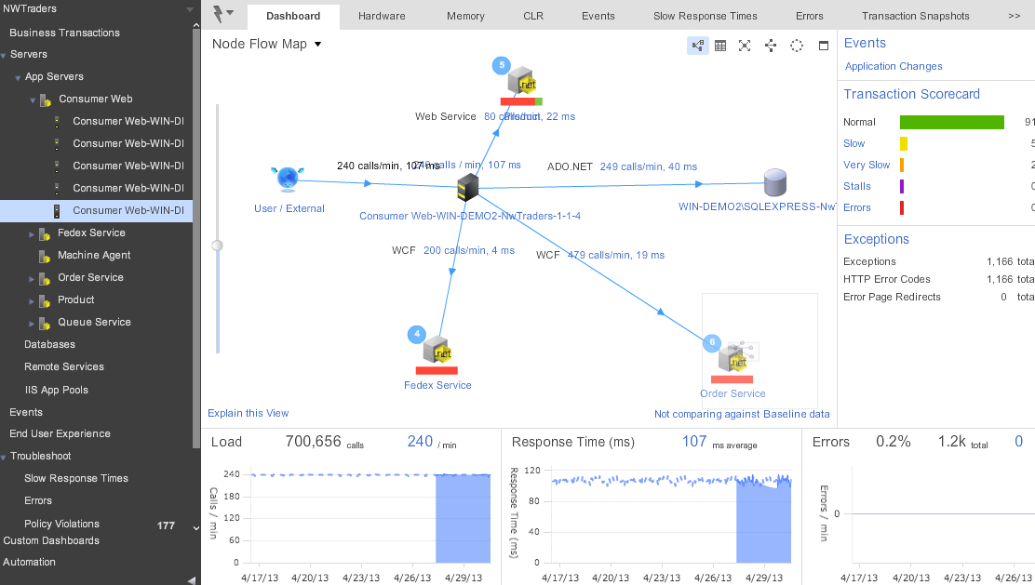
.NET node dashboard
Notes:
.NET node dashboard looks similar to java node dashboard but includes few difference of the platforms.
Though mainly the look and feel is the same the content of specific tabs is different comparing to java.
Hardware tab will show information based on the windows performance counters, memory information includes perf counters collected regarding GC, and CLR tab brings the details about the .NET app and process details.

Slide 11
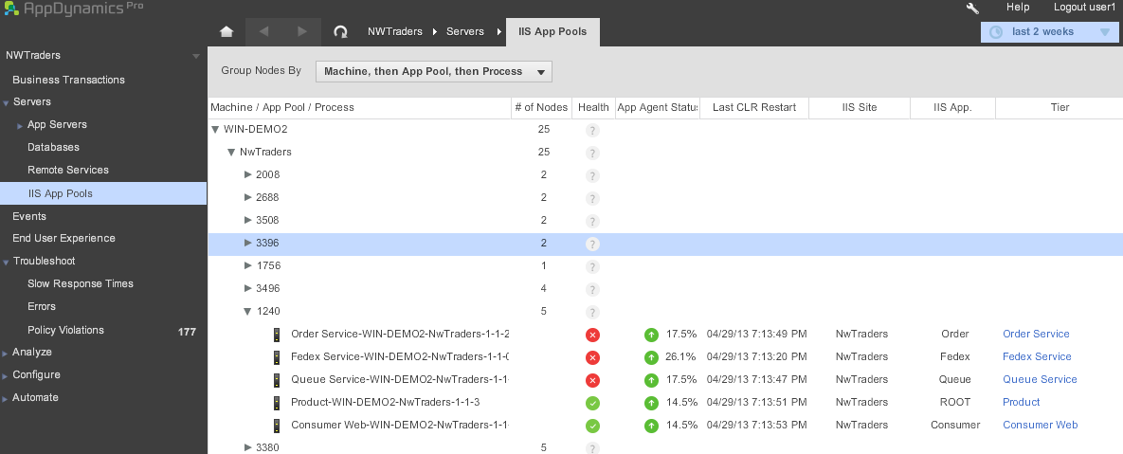
IIS AppPool view
Notes:
IIS AppPool view is totally new comparing to java, where nothing similar is available.
This view shows together all nodes, tiers, IIS web sites, applications and AppPools and how they are mapped to each other.
It is important to understand which actual web site is monitored and what application and map it to the IIS web applications.

Slide 12
Gotcha’s
Monitoring Windows Services
Global environment variable is required
AppDynamicsAgent_EnableInProcesses=myapp.exe|myotherapp.exe|myservice.exe
Automatic vs. manual mode
App.exe.config file changes
Service restart
Notes:
There are few gotcha’s about the .NET agent and it’s configuration.
First one is related to monitoring the windows services .net apps.
Currently the configuration wizard doesn’t allow configuring the windows service for monitoring, this is a manual process to enable those.
Users still need to run the configuration wizards to setup logging, application which enables machine agent.
Next step is to create a global environment variable that would contain the windows service executable name with extension but without path, for multiple services separate those by pipe.
When wizard is setup with the automatic option no other steps should be required, just restart the service.
For the manual mode configuration user needs to find and edit the application configuration which is named same way as executable with .config extension appended.

Slide 13
Gotcha’s
.NET node naming
<tier-name>-<machine-name>-<app-pool-name|exe-name><process-index>-<clr-count>-<app-domain-index>
IIS recycle and nodes
Notes:
Second gotcha to understand how the .NET nodes are named. While java required manual node name to be set - .NET auto assign node name based on the formula on this slide.
Various indexes will take in place when two identical application are running, in this case the index will be increased to uniquely identify the node.
It is very useful to look at the node through the prism of IIS AppPool view.
One more item to understand – during IIS AppPool recycle for a short time IIS has two worker processed running together, so this introduced some overlap for high availability.
.NET agent is loaded into both instances of those worker processes which forces to have two nodes registers at the controller, this is where the index is increased.
But in short timeframe the second instance of worker process stops, therefore controller shows inactive nodes located near to the active ones.
This situation is normal and related to the nature of the IIS, though engineering team is working to improve the UI around it to make it less confusing.

Slide 14
Thank You

